Slide 1
Interpretability for Detecting Adversarial Attacks
Task: MNIST digit recognition
Terminology:
Task Network – The model performing the digit recognition task.
Task Input Images – Input to the task network. Either unaltered images from the MNIST data set or adversarial attack images generated using one of three adversarial attack method.
(LBFGSAttack, DeepFoolAttack, GradientAttack from: https://github.com/bethgelab/foolbox )
Relevancy Map Image - Relevancy map decision explanations from classifications made by the task network on task input images. (Generated by LRP Deep Taylor Composition) - https://github.com/VigneshSrinivasan10/interprettensor
Input Image Adversarial Classifier (Input Classifier) – A model trained on the task input images being fed to the task network (so either an original MNIST image or an adversarial attack image).
Relevancy Map Adversarial Classifier (Relevancy Classifier) – A model trained on the relevancy maps generated from the task network classifications.

Slide 2
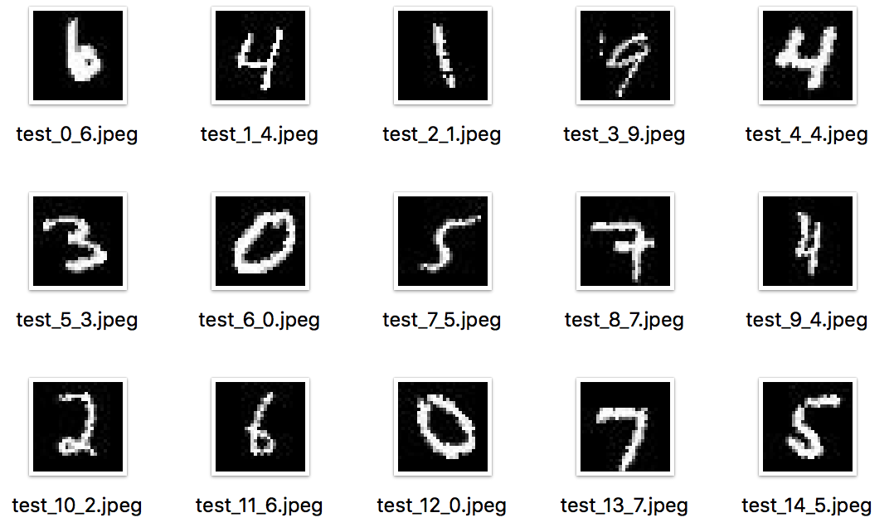
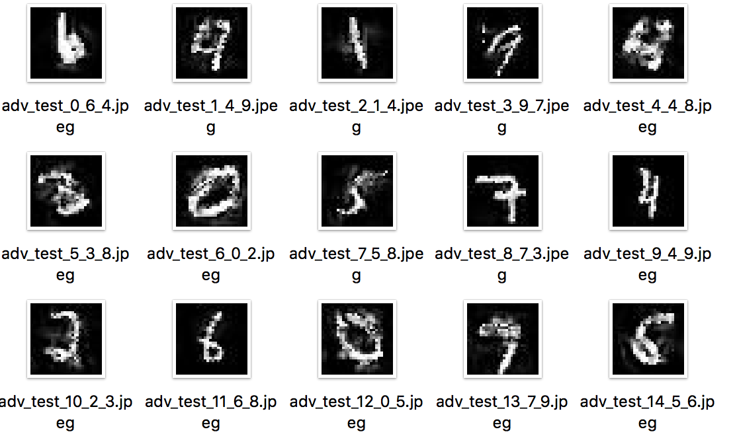
Interpretability for Detecting Adversarial Attacks
Task Input Images - LBFGSAttack
Original Images (file format = test_[id]_[ground_truth].jpeg
Adversarial Images (adv_test_[id]_[ground_truth]_[classification].jpeg

Slide 3

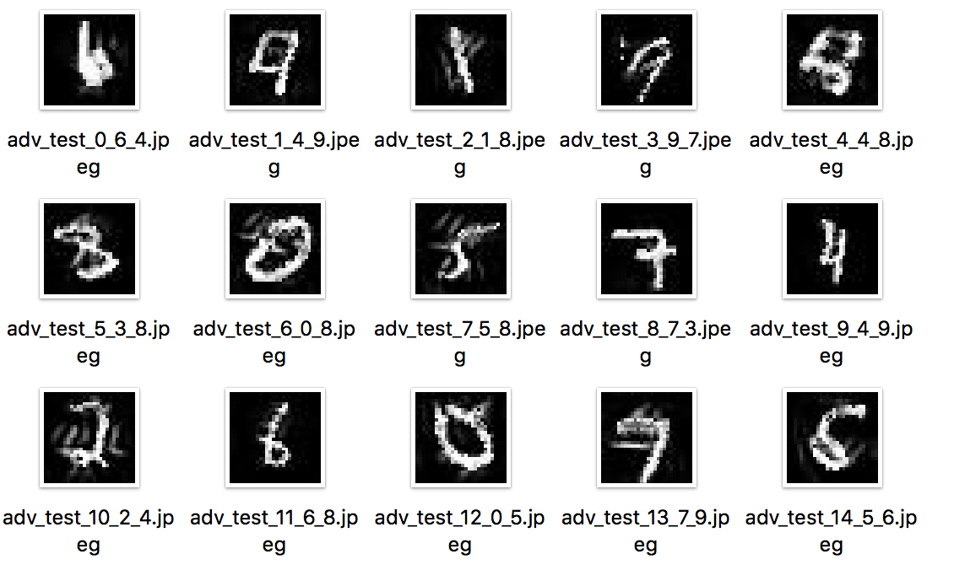
Interpretability for Detecting Adversarial Attacks
Task Input Images – DeepFoolAttack
Original Images (file format = test_[id]_[ground_truth].jpeg
Adversarial Images (adv_test_[id]_[ground_truth]_[classification].jpeg

Slide 4
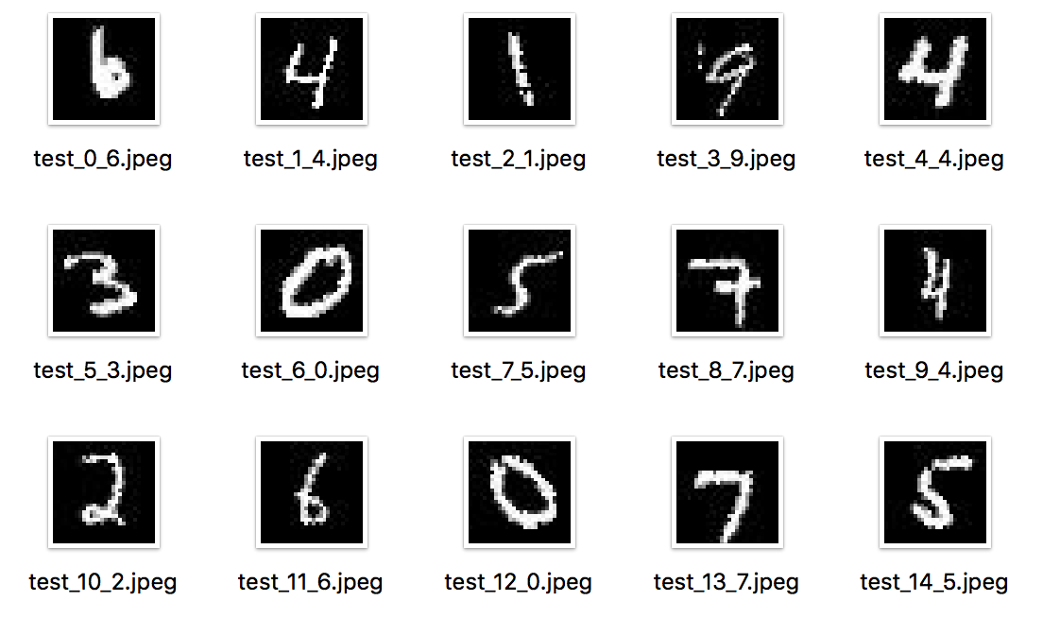

Interpretability for Detecting Adversarial Attacks
Task Input Images - GradientAttack
Original Images (file format = test_[id]_[ground_truth].jpeg
Adversarial Images (adv_test_[id]_[ground_truth]_[classification].jpeg

Slide 5
Interpretability for Detecting Adversarial Attacks
Task Input Imageas
Some attack images seem of a quality that would stop them being a viable attack.
Do we improve the mnist attack algorithms (fine tuning, try another algorithm, etc)?
Do we change task to something that will generate attacks which are less detectable to the human eye?

Slide 6
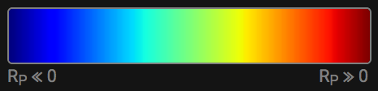
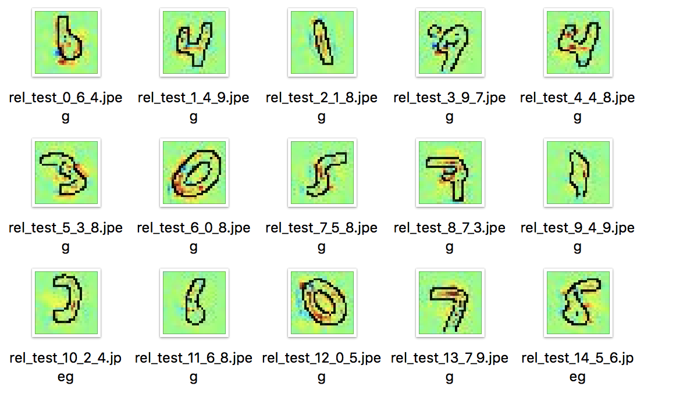
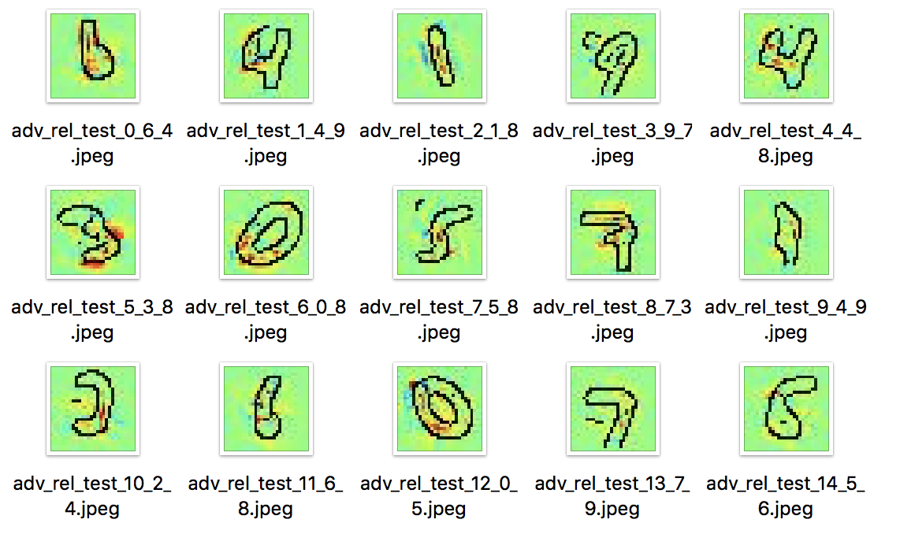
Interpretability for Detecting Adversarial Attacks
Relevancy Images - LBFGSAttack
Red is evidence for the class, Blue is evidence against the class, Green is neutral
Original Images (file format = rel_test_[id]_[ground_truth].jpeg
Adversarial Images (adv_rel_test_[id]_[ground_truth]_[classification].jpeg

Slide 7
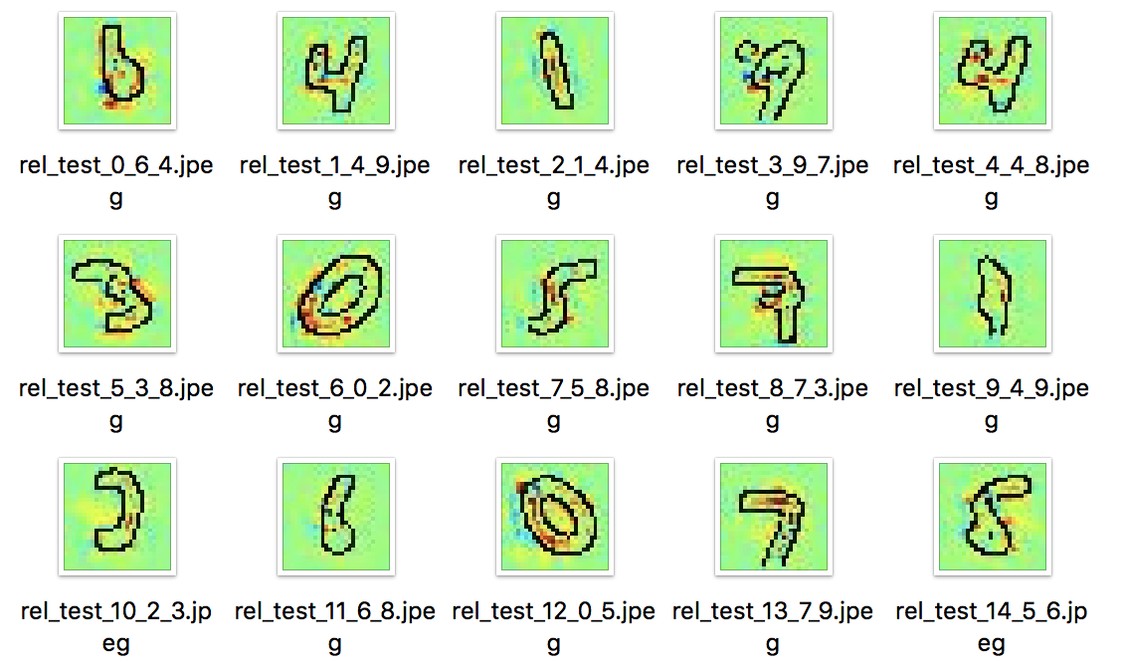
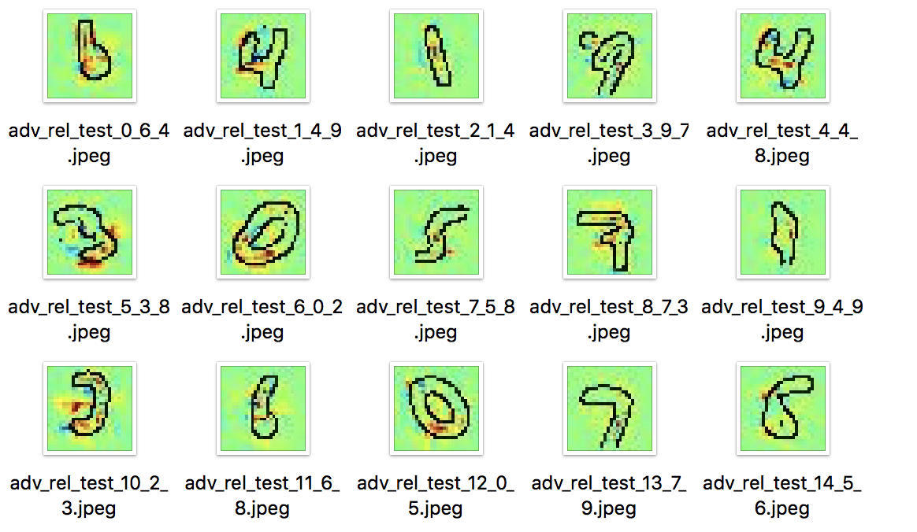
Interpretability for Detecting Adversarial Attacks
Relevancy Images - DeepFoolAttack
Red is evidence for the class, Blue is evidence against the class, Green is neutral
Original Images (file format = rel_test_[id]_[ground_truth].jpeg
Adversarial Images (adv_rel_test_[id]_[ground_truth]_[classification].jpeg

Slide 8
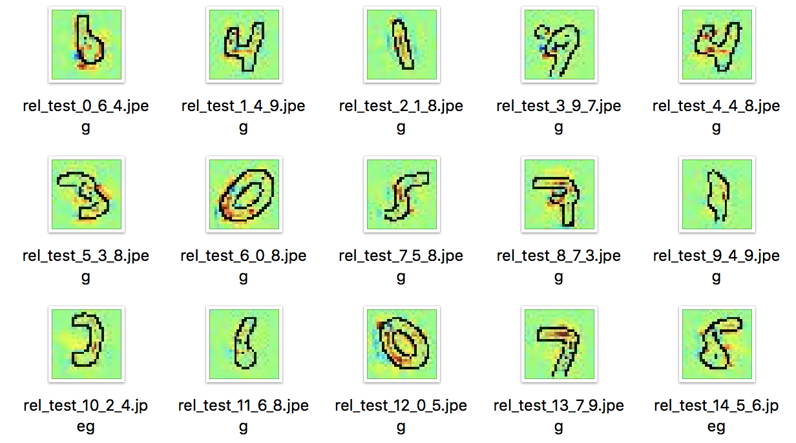
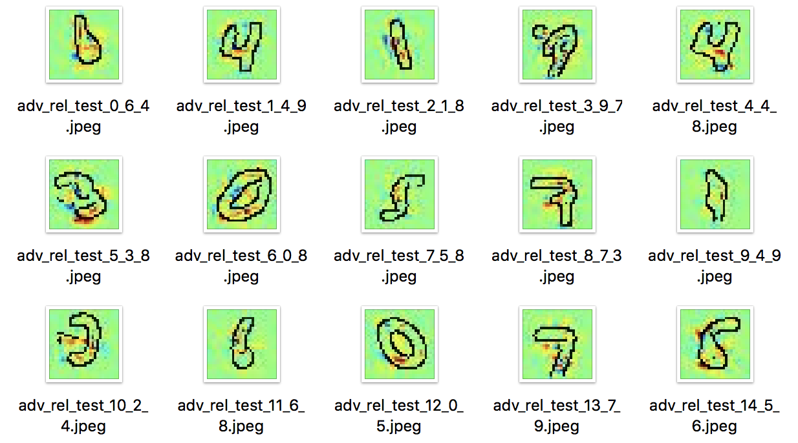
Interpretability for Detecting Adversarial Attacks
Relevancy Images - GradientAttack
Red is evidence for the class, Blue is evidence against the class, Green is neutral
Original Images (file format = rel_test_[id]_[ground_truth].jpeg
Adversarial Images (adv_rel_test_[id]_[ground_truth]_[classification].jpeg

Slide 9
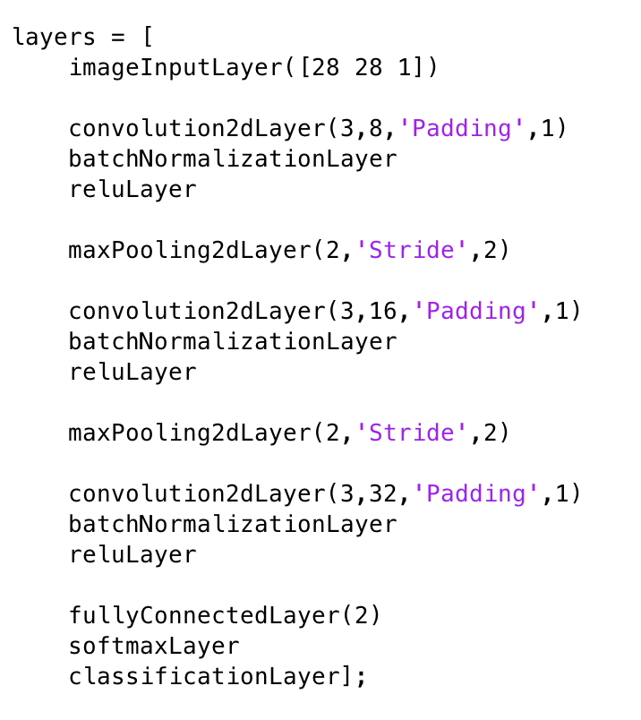
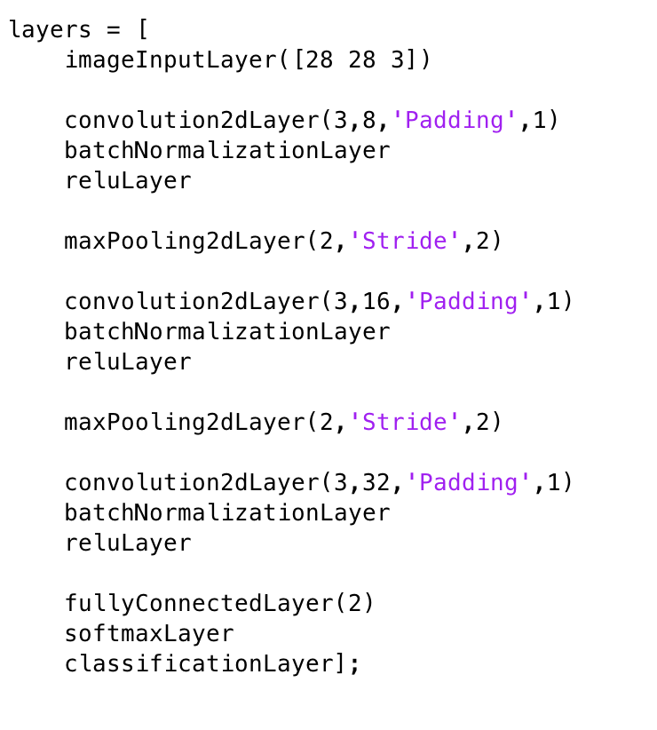
Interpretability for Detecting Adversarial Attacks
Input Image Adversarial Classifier (Input Classifier)
Relevancy Map Adversarial Classifier (Relevancy Classifier)
Other structures were tried for Relevancy Classifier (very small gains (if any) were seen to the upcoming shown results)

Slide 10
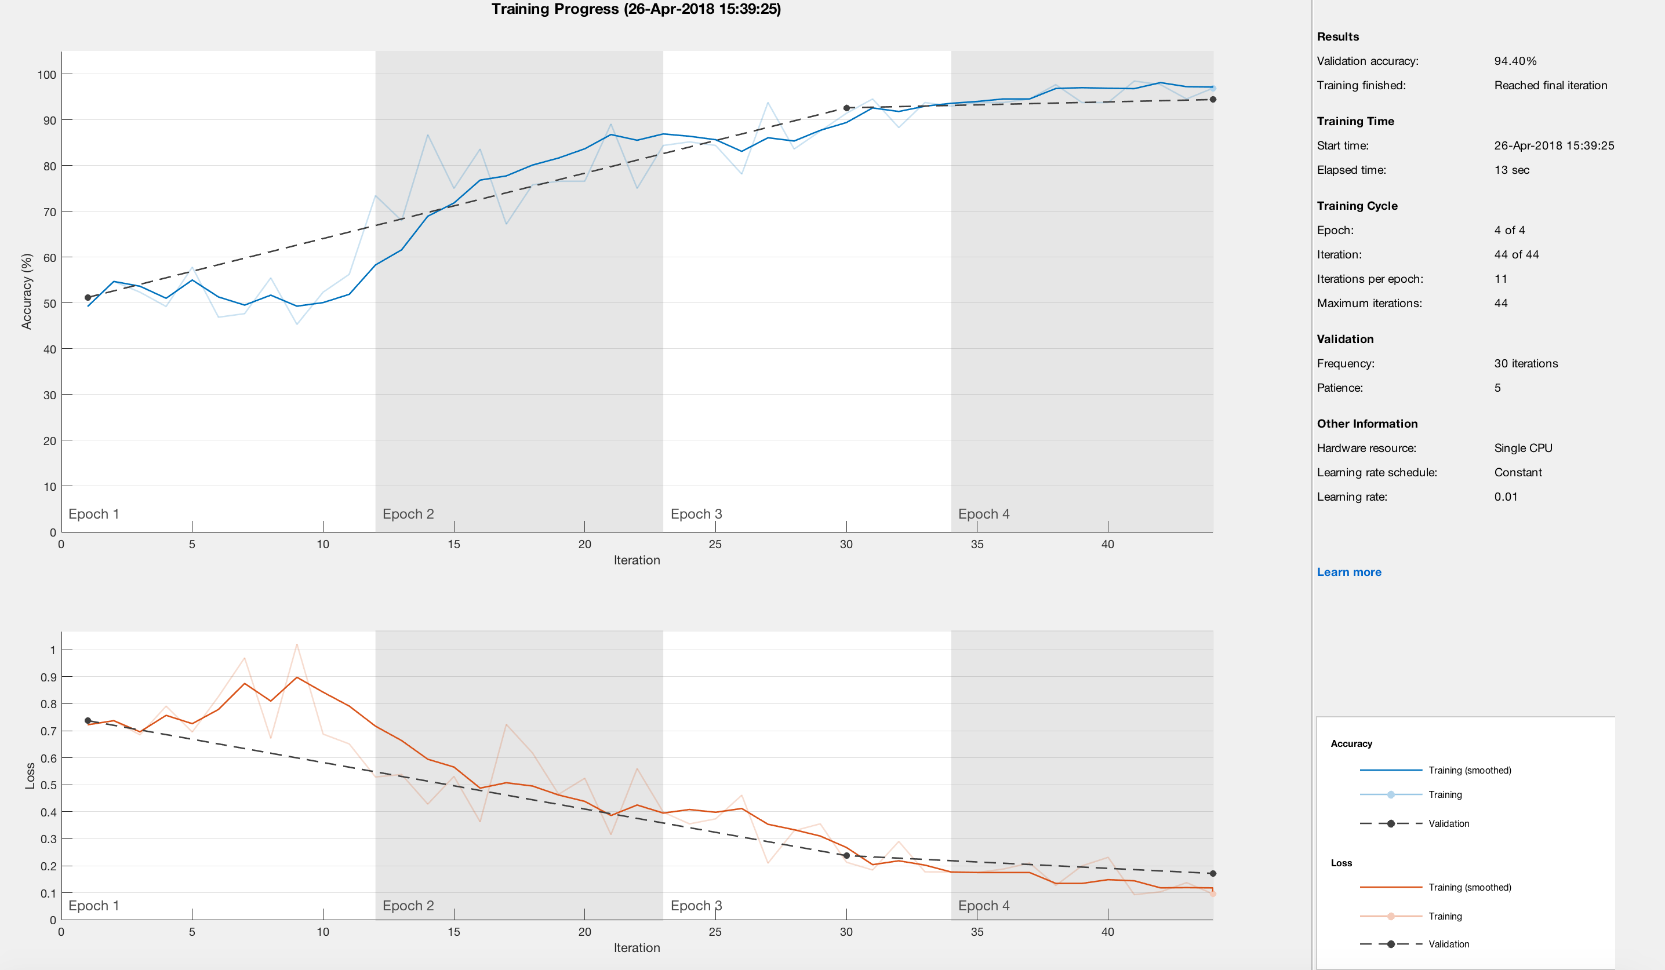
Interpretability for Detecting Adversarial Attacks
Input Classifier – LBFGSAttack - 94.4%

Slide 11
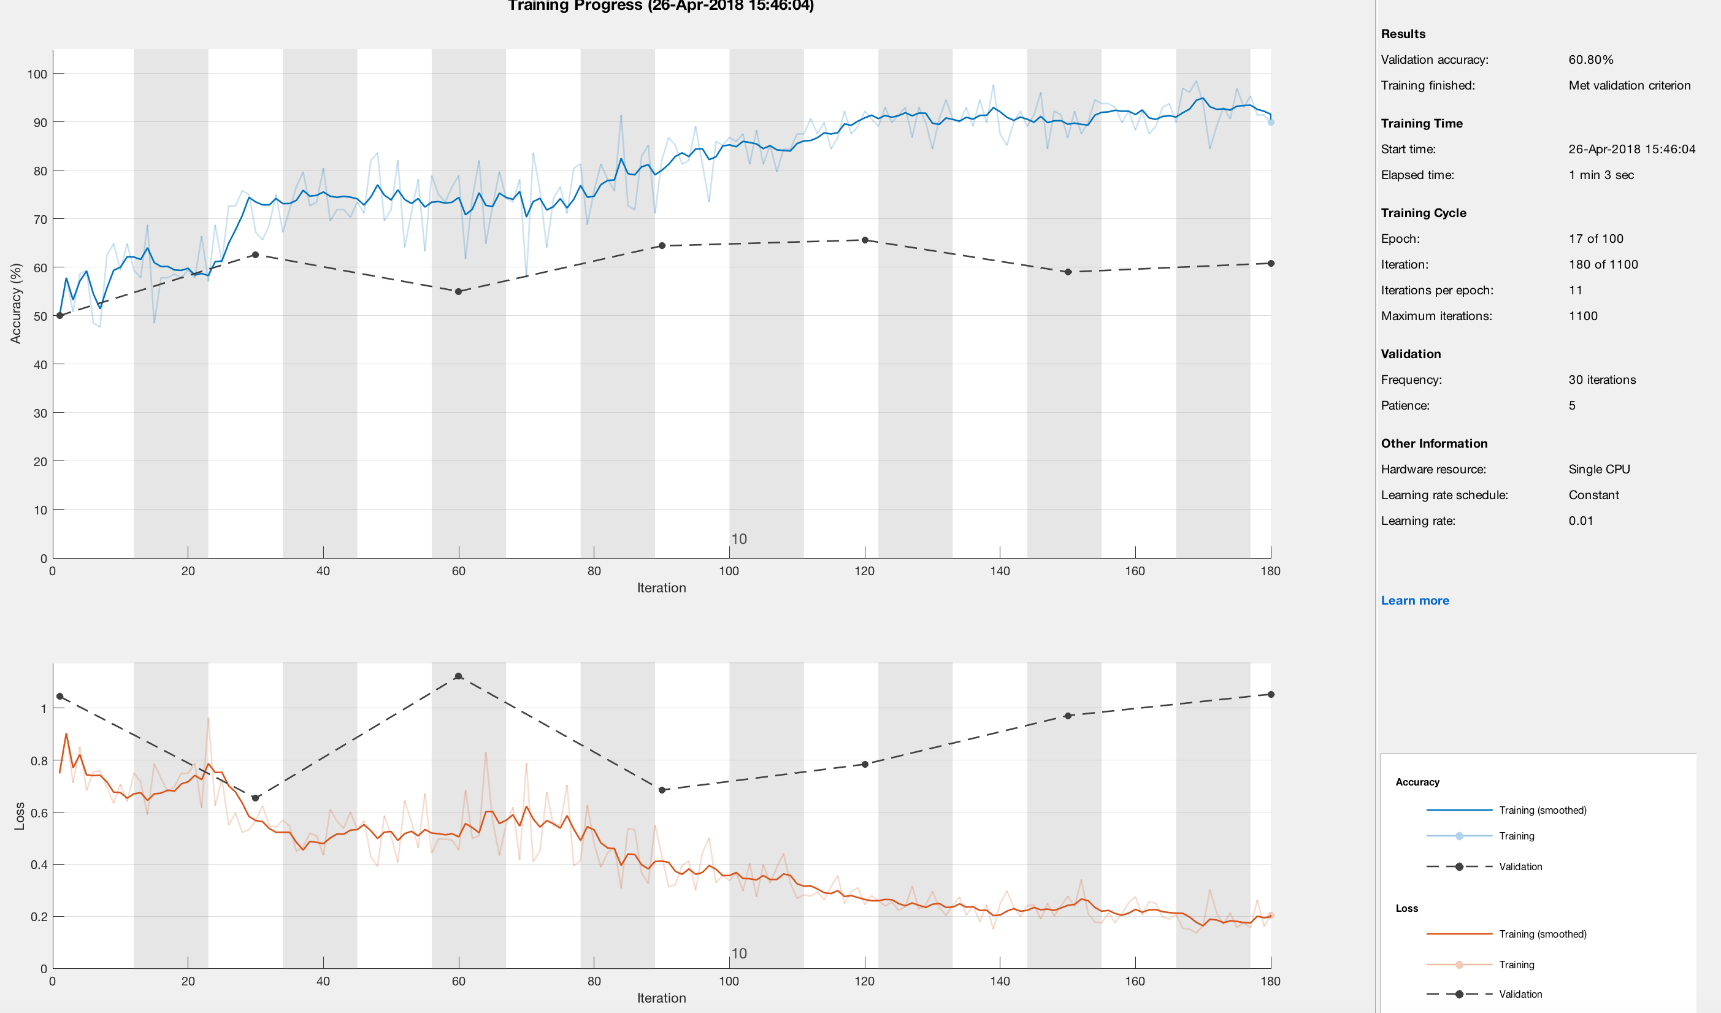
Interpretability for Detecting Adversarial Attacks
Relevancy Classifier – LBFGSAttack – 60.8%

Slide 12
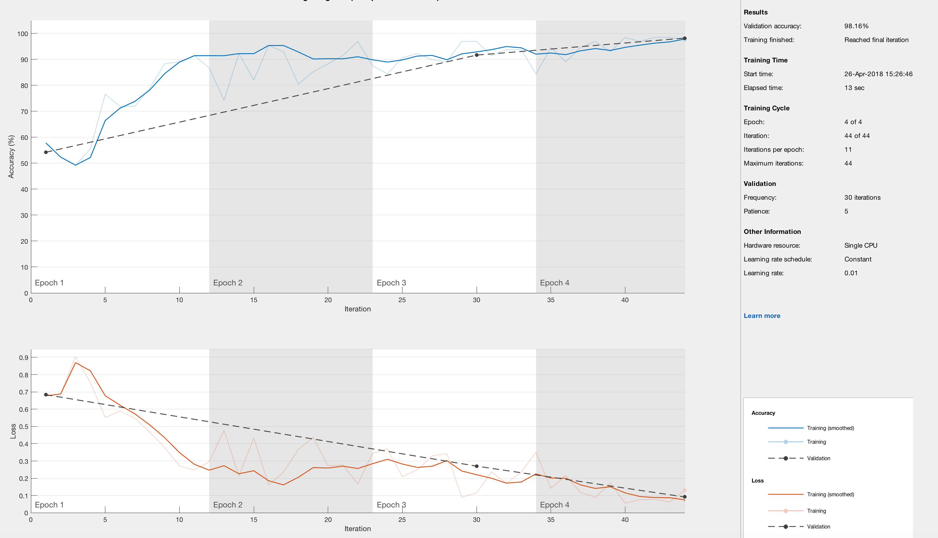
Interpretability for Detecting Adversarial Attacks
Input Classifier – DeepFoolAttack – 98.16%

Slide 13
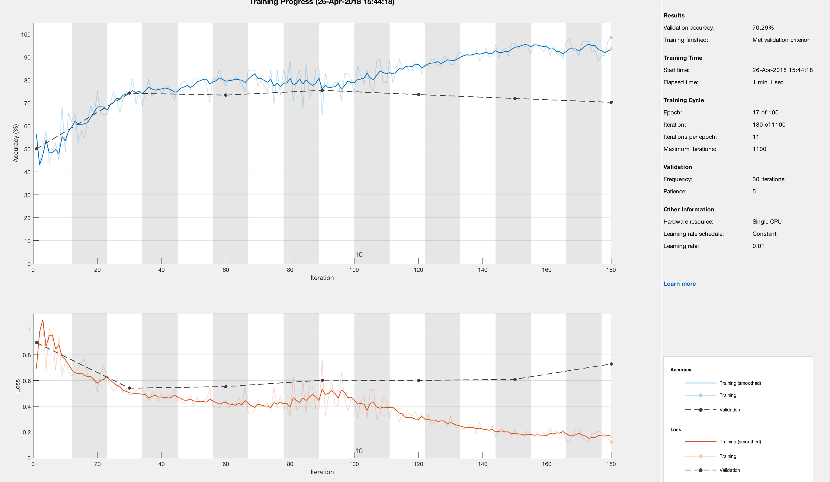
Interpretability for Detecting Adversarial Attacks
Relevancy Classifier – DeepFoolAttack – 70.29%

Slide 14
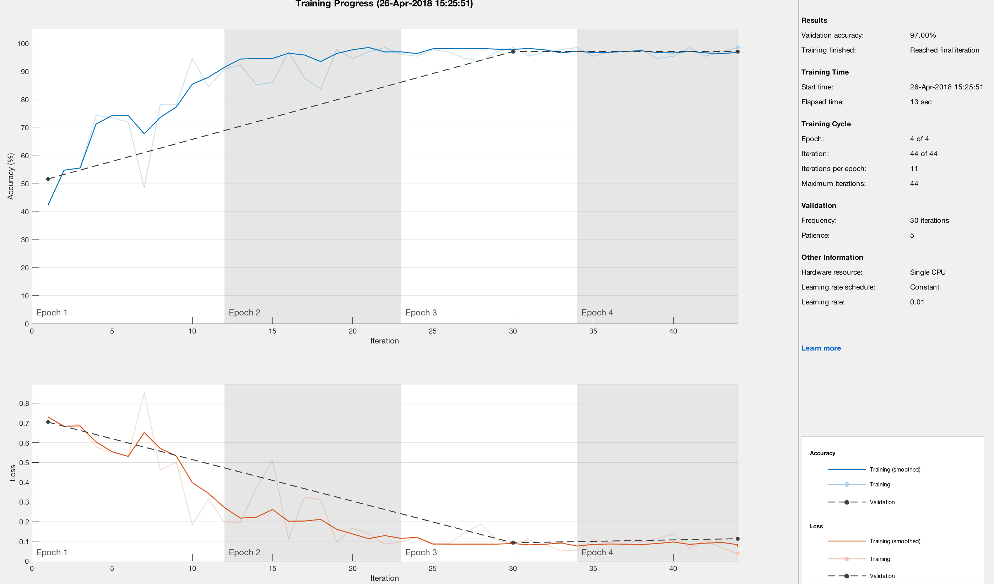
Interpretability for Detecting Adversarial Attacks
Input Classifier – GradientAttack – 97%

Slide 15
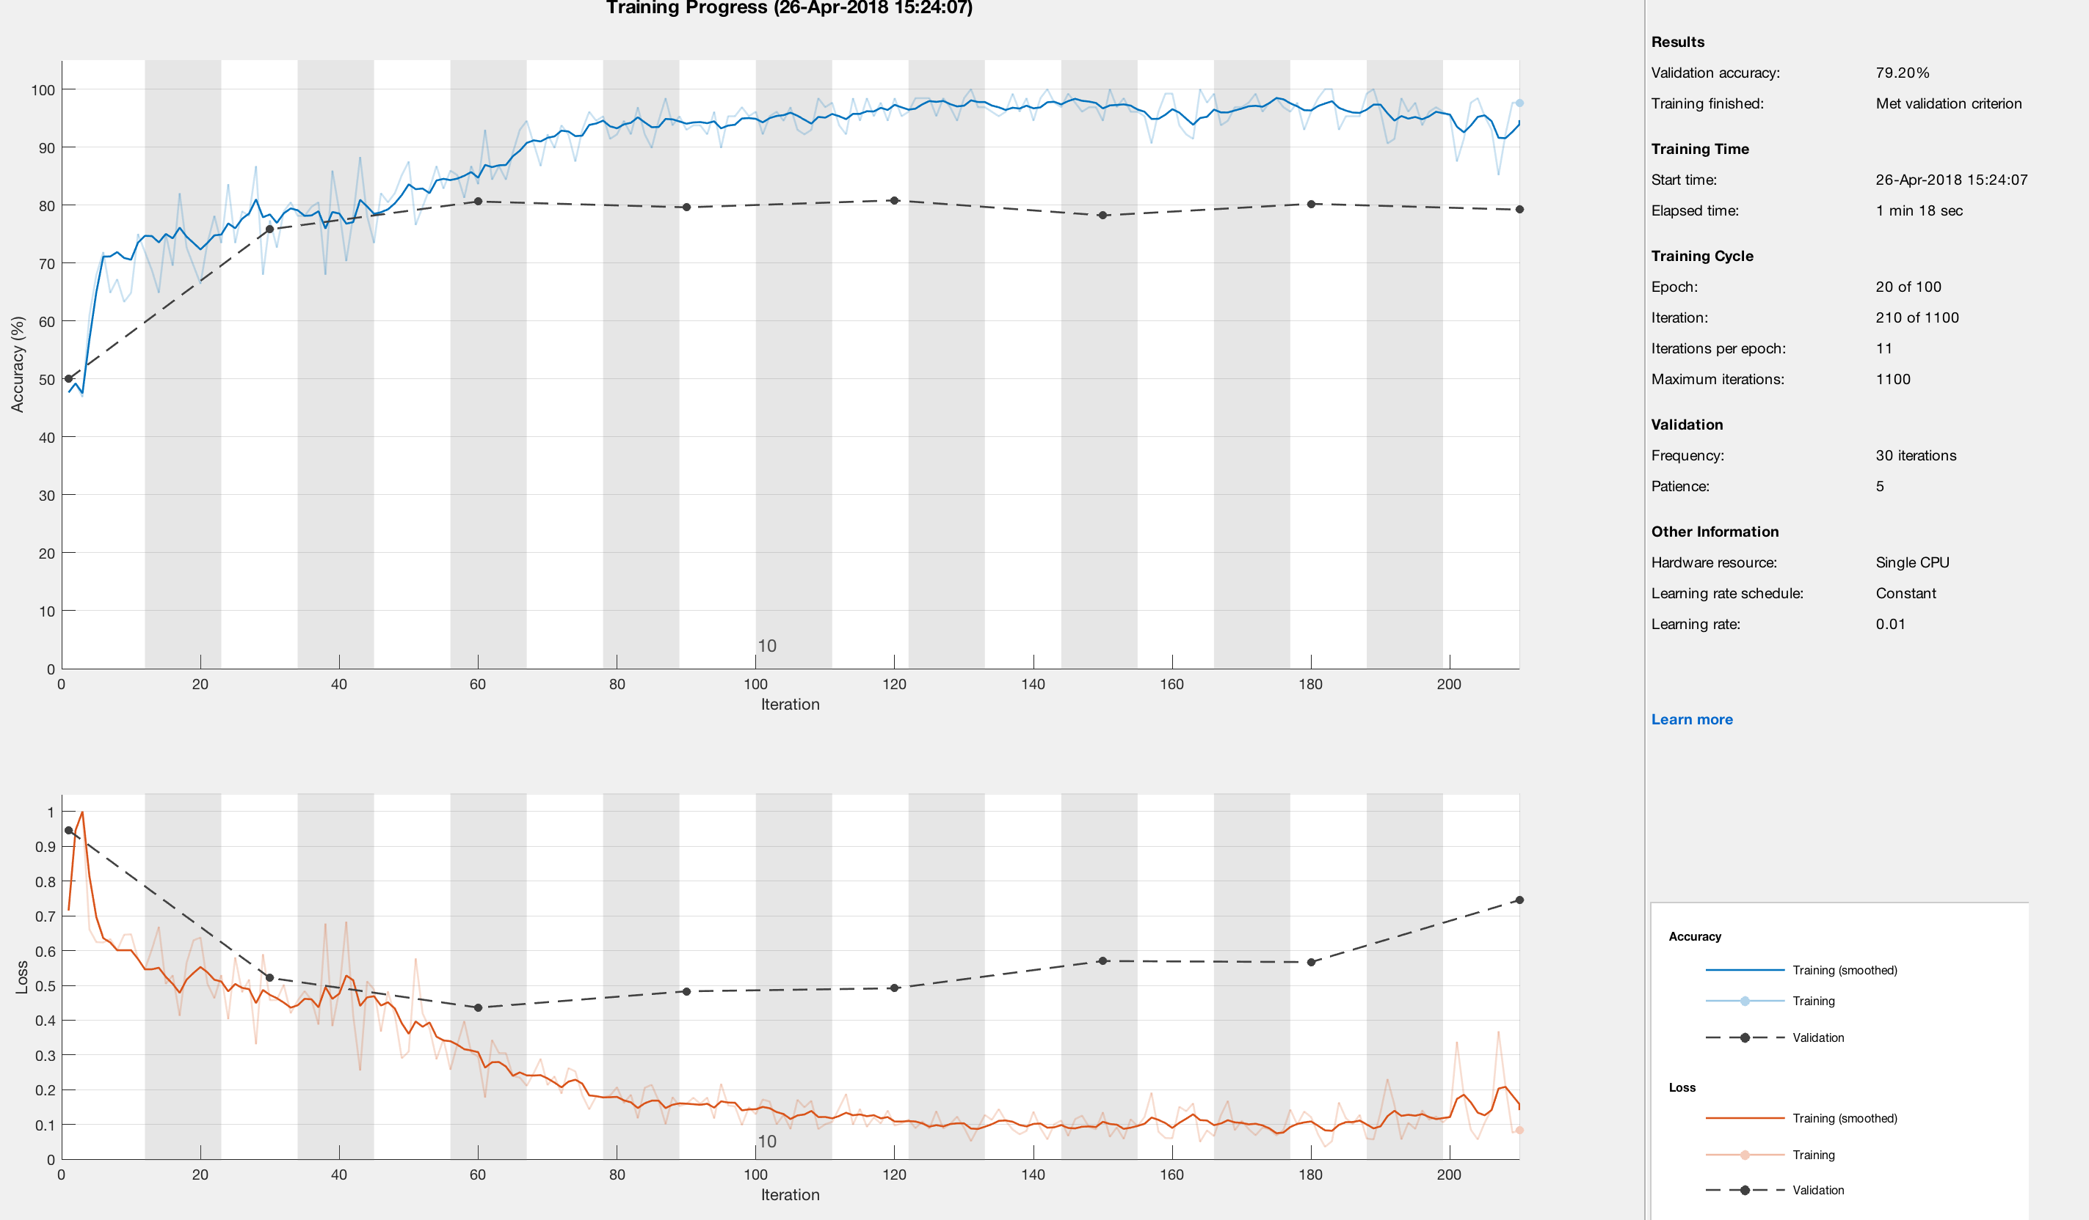
Interpretability for Detecting Adversarial Attacks
Relevancy Classifier – GradientAttack – 79.2%

